Slide 1
PROJECT REPORT
Visual Check
Self-hosted visual regression testing tool
Thái · Bình · Thanh
April 2026

Slide 2
What is Visual Check?
Visual Check is a self-hosted visual regression testing tool inspired by Percy (BrowserStack). It automatically captures screenshots of your live application, fetches design baselines from Figma, diffs them pixel-by-pixel, and presents results in a review dashboard.
Design Source
Capture
Review
Figma frames as the ground truth baseline
Playwright screenshots of the live application
Dashboard to approve or reject visual changes
Inspired by Percy by BrowserStack — built in-house, runs entirely locally

Slide 3
System Architecture
Monorepo — 3 packages + shared core
@visual-check/core
@visual-check/playwright
@visual-check/dashboard
Shared library
Test runner
Frontend app
▸ Figma API client
▸ Playwright config
▸ Project management
▸ pixelmatch diff engine
▸ Screenshot capture
▸ Build history view
imports
imports
▸ Local file storage
▸ DOM label lookup
▸ Diff viewer UI
▸ AI integration layer
▸ Figma node lookup
▸ Approve / reject flow
▸ Build & result manifests
▸ AI label generation
▸ REST API routes
pnpm workspaces monorepo · TypeScript · Node 20+

Slide 4
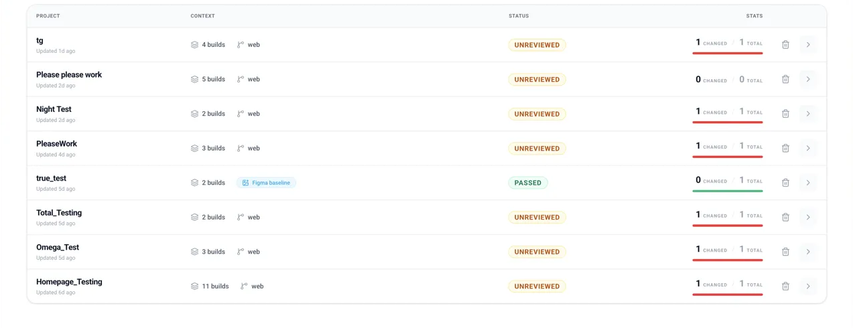
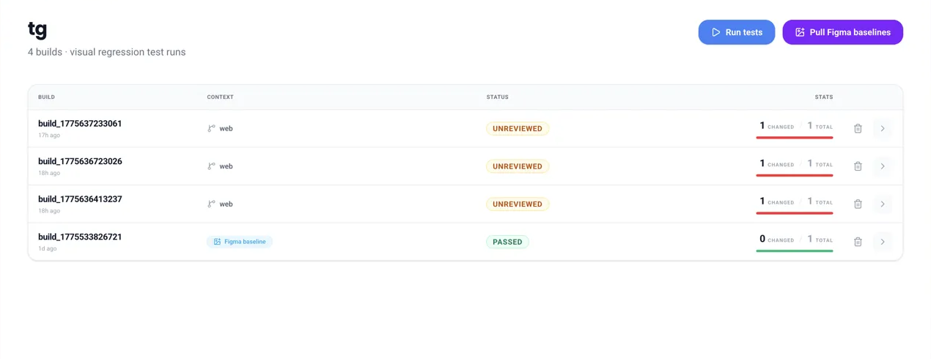
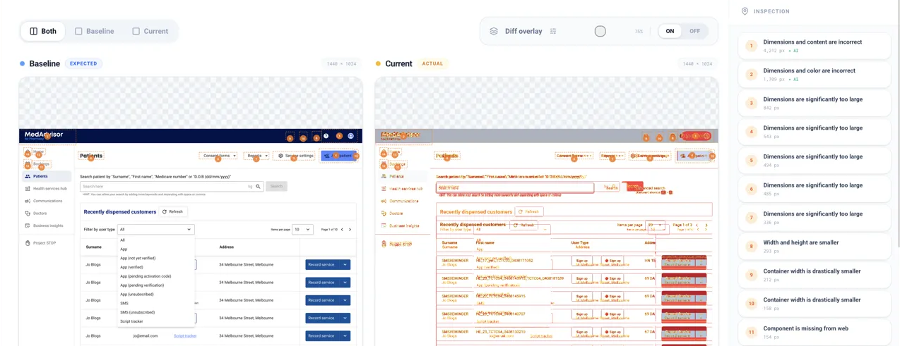
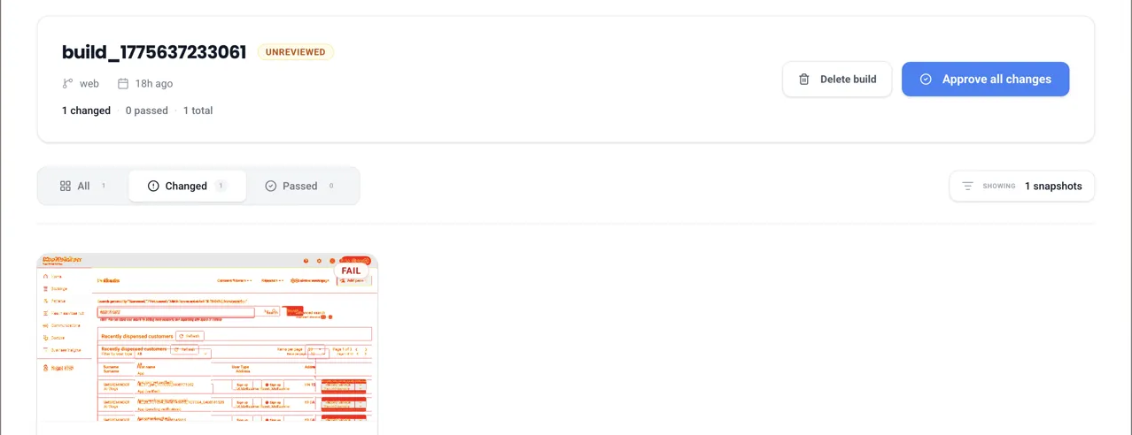
Frontend Interface Overview
Projects Dashboard
Build Execution View
Patient Data Comparison
Review & Approval Workspace
Next.js 16 Dashboard Core Components · React UI

Slide 5
End-to-End Workflow
From Figma design to reviewed result in one flow
📁
📐
🎭
📊
🔬
✅
1
2
3
4
5
6
Create project
in dashboard
Pull Figma
baselines
Run Playwright
tests
View build
results
Inspect diff
+ AI analysis
Approve or
reject changes
🔐 Authentication support
Protected apps are fully supported. The dashboard provides a guided browser session flow — log in once (including QR / 2FA), press Confirm, and the session is saved to auth.json. All subsequent Playwright runs load it automatically. JWT tokens can also be injected via the run modal for token-based auth.

Slide 6
Thank you

